Slide 1
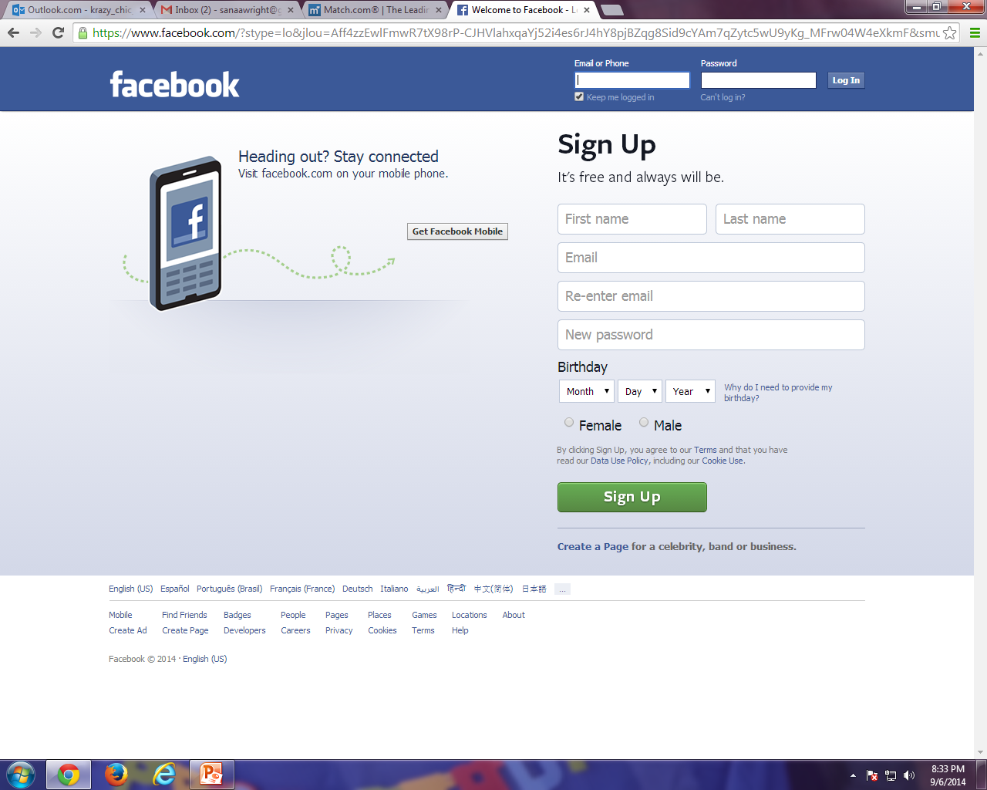
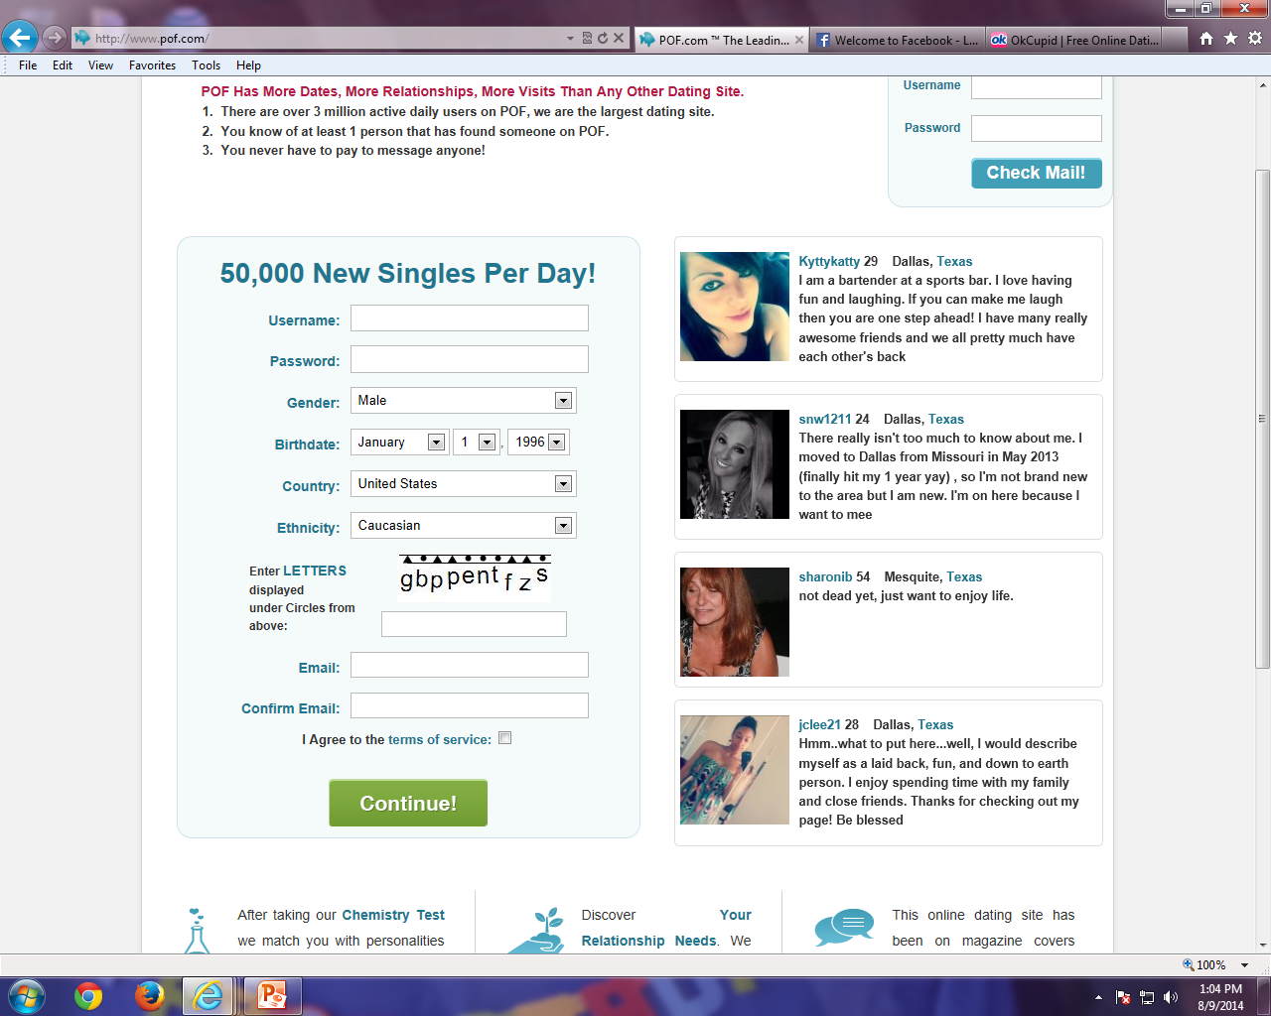

Gifmatch
Gif
Sign Up
OR
Mobile App About us Terms of service Privacy Cookies Help Advertise on Gifmatch.com
Gifmatch © 2014 · English (US)

Slide 2
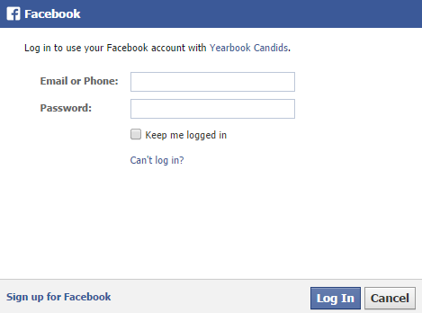
Put Gifmatch here

Slide 3
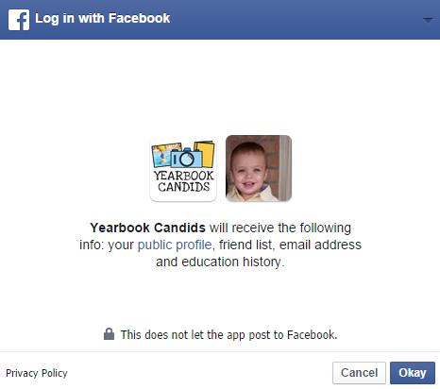
Put Gifmatch here
Our privacy policy here

Slide 4
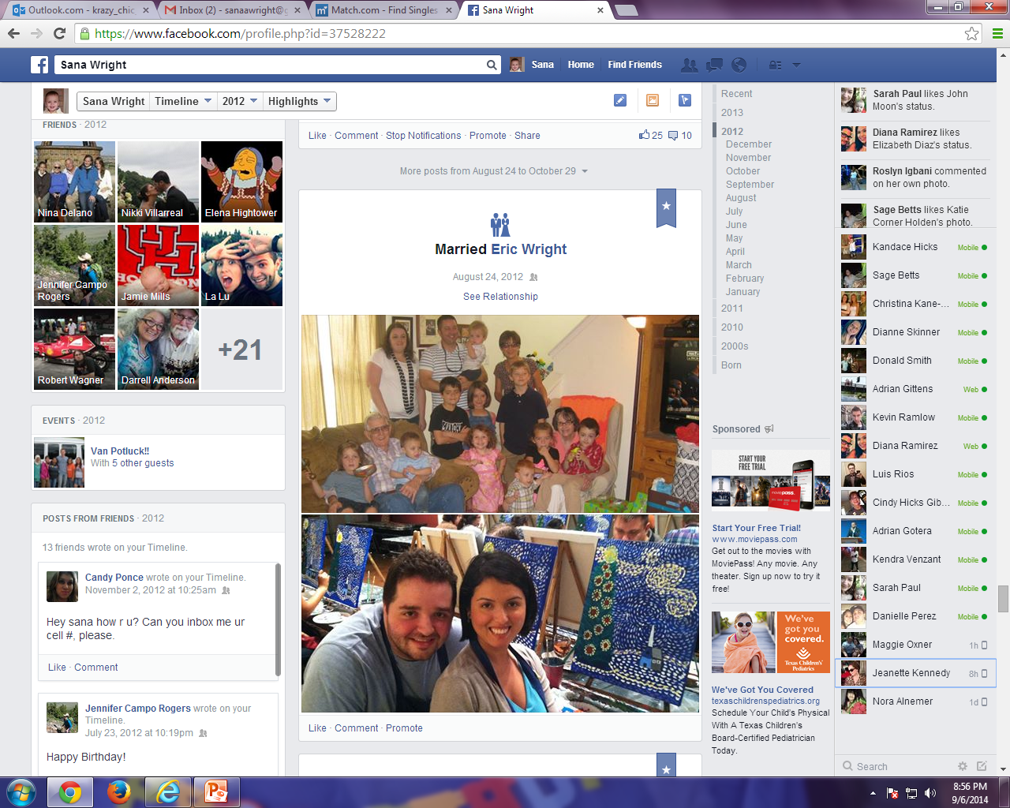

Gifmatch.com
Search for anyone who has given you a gift idea in the past and ask for another suggestion!
Welcome username
Home Search my gift ideas Search my personal shopper Messages Invite friends Wish list Privacy Account Settings Events
Chat box
To share gift ideas and to help others who need ideas
All fields drop down menu
Seeking a unique present for
She/he is between ages ___ to ___ and
lives in _____________
postal code _________
See genealogy file
I am a _________
My _________
Provide city, state*
What is the occasion?
__________
See occasion file 2
* Required field

Slide 5
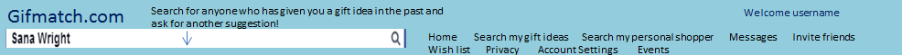
Chat box
To share gift ideas and to help others who need ideas
Create your Profile - Tell us a little about yourself
How do you like to spend your free time?
Do you prefer present or money?
Would you rather have your next present be donated to a charity? Yes or no

Slide 6
Wish List
Sara
Anam
Seema
Robyn
Colin
Sandra
Harold
Inara
Liam
Eric
Rayan
Cindy
Gina
These wish lists are a function of all the suggestions that this website have give me for Sara, Anam etc…
These will eventually be links!
Chat box
To share gift ideas and to help others who need ideas
My Wish List
Add a function that allows the user to go to any website and capture the item they want.
Things that I want
Things that I need
Cookware
Make-up
Clothes/Accessories
Jewelry
Recreational items
iPhone case
Computer laptop
shoes
My short term goal
My long term goal
Vacation
iPhone
- Paying for tuition (people can put money towards this goal)
Buy a car
Repair house
Buy RV

Slide 7
Home

Slide 8
Search my gift ideas

Slide 9
Search my personal shopper

Slide 10
Messages

Slide 11
Invite Friends

Slide 12
Wish List

Slide 13
Privacy

Slide 14
Account Settings

Slide 15
Events

